Slide 1
"How I created a non-wiki wiki in 5 days"
A pro-Django presentation: Brandon W. King
SoCal Piggies - May 2007

Slide 2
Non-wiki wiki?
A website that looks like a website, but behaves like a wiki.
Mediawiki, MoinMoin, look like wikis.
Websites tend to have navigation menus.
Wikis tend to have navigation within the wiki page.

Slide 3
Why?
I wanted a web site for the lab that:
Looked like a website.
Had a menu manager.
And could be edited by biologists in the lab.

Slide 4
Requirements
Has to be written faster than Diane can learn Zope.
Allowing edits from command-line.
Revision control of pages

Slide 5
The How:
Oswd.org
Django
PySVN
FCKEditor

Slide 6
Initialize Django
Django-admin.py startproject woldcms
woldcms/
__init__.py
manage.py
settings.py
urls.py

Slide 7
Manage.py is your friend
cd woldcms/
python manage.py startapp pages
woldcms/pages/
__init__.py
models.py
views.py

Slide 8
Update woldcms/settings.py
Update database settings:
DATABASE_ENGINE = 'sqlite3' # 'postgresql_psycopg2', 'postgresql', 'mysql', 'sqlite3' or 'ado_mssql'.
DATABASE_NAME = '/home/king/proj/woldlab-2.0/woldlabwww.db' # Or path to database file if using sqlite3.
DATABASE_USER = '' # Not used with sqlite3.
DATABASE_PASSWORD = '' # Not used with sqlite3.
DATABASE_HOST = '' # Set to empty string for localhost. Not used with sqlite3.
DATABASE_PORT = '' # Set to empty string for default. Not used with sqlite3.
Update installed apps:
INSTALLED_APPS = (
'django.contrib.admin',
'django.contrib.auth',
'django.contrib.contenttypes',
'django.contrib.sessions',
'django.contrib.sites',
'woldcms.page'
)

Slide 9
Time to create the Models
Django uses a custimized sqlalchemy for DB layer.
On to the models…(After documentation detour)

Slide 10
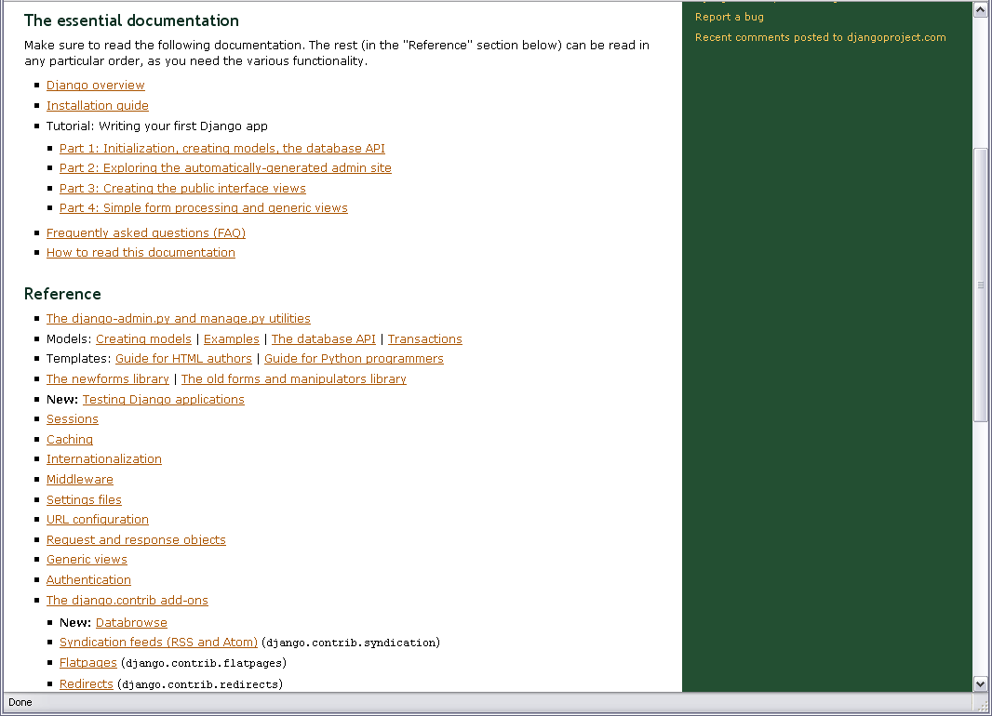

Slide 11
Add the models
Page
MenuSet
Horizontal Menu (ref to “Menu”)
Vertical Menu (ref to “Menu”)
Menu
Menu Item (Many-to-many)
Menu Sub Item (Many-to-many)

Slide 12
Page Model
from django.db import models
class MenuSubItem(models.Model):
class Admin: pass
# Internal name (i.e. mussa_download)
id_name = models.CharField(maxlength=100)
# Name to display on page
display_name = models.CharField(maxlength=100)
# Priority
priority = models.PositiveSmallIntegerField(default=50)
# Internal
internal = models.BooleanField(default=False)
# Link to internal page
page_name = models.SlugField(maxlength=50, blank=True)
# Link to url
url = models.URLField(blank=True)
def __str__(self):
return '(%s) %s' % (self.id_name, self.display_name)

Slide 13
Menu Model
class Menu(models.Model):
class Admin: pass
name = models.CharField(maxlength=100)
menu_items = models.ManyToManyField(MenuItem)
def __str__(self):
return self.name

Slide 14
Menu Item Model
class MenuItem(models.Model):
class Admin: pass
# Internal name (i.e. mussa_download)
id_name = models.CharField(maxlength=100)
# Name to display on page
display_name = models.CharField(maxlength=100)
# Priority
priority = models.PositiveSmallIntegerField(default=50)
# Internal
internal = models.BooleanField(default=False)
# Link to internal page
page_name = models.SlugField(maxlength=50, blank=True)
# Link to url
url = models.URLField(blank=True)
# Any sub-menu items (optional)
sub_menu_items = models.ManyToManyField(MenuSubItem, blank=True)
def __str__(self):
return '(%s) %s' % (self.id_name, self.display_name)

Slide 15
Model Field Types
AutoField
BooleanField
CharField
CommaSeparatedIntegerField
DateField
DateTimeField
DecimalField
EmailField
FileField
FilePathField
FloatField
ImageField
IntegerField
IPAddressField
NullBooleanField
PhoneNumberField
PositiveIntegerField
PositiveSmallIntegerField
SlugField
SmallIntegerField
TextField
TimeField
URLField
USStateField
XMLField

Slide 16
Model Field Options
null
blank
choices
core
db_column
db_index
default
editable
help_text
primary_key
radio_admin
unique
unique_for_date
unique_for_month
unique_for_year
validator_list

Slide 17
Create db, tables, and syncdb
In woldcms/
python manage.py sqlall pages #creates new db (if d.n.e.), tables, indexes, etc.
python manage.py syncdb #Sets up authentication, admin, etc.

Slide 18
Fireup some Django goodness
cd woldcms/
python manage.py runserver #now on localhost:8000
<snap fingers> now at:
http://woldlab.caltech.edu/admin/

Slide 19
Mmm… data… Got Views?
We can now input the data we need through the admin interface.

Slide 20
A simple view
from django.template import Context, loader
from django.http import HttpResponse, HttpResponseRedirect
def index(request):
return HttpResponse(“<h1>Look a non-wiki!</h1>”)
def punish_user(request):
return HttpRequestRedirect(‘http://microsoft.com’)

Slide 22
The ONLY down side to Django…
Now to hook up the view to a url.
{% cue documentation %}

Slide 24
woldcms/urls.py:
from django.conf.urls.defaults import *
from woldcms import settings
urlpatterns = patterns('',
# Uncomment this for admin:
(r'^admin/', include('django.contrib.admin.urls')),
(r'^html/', include('woldcms.page.urls')),
#(r'^accounts/login/', 'django.contrib.auth.views.login'),
(r'^login/', 'woldcms.page.views.login'),
(r'^logout/', 'woldcms.page.views.logout'),
(r'^img/(?P<path>.*)$', 'django.views.static.serve', {'document_root': settings.MEDIA_ROOT}),
)
woldcms/pages/urls.py:
from django.conf.urls.defaults import *
urlpatterns = patterns('',
(r'(?P<page_name>[a-zA-Z0-9_]+)/edit/$', 'woldcms.page.views.edit'),
(r'(?P<page_name>[a-zA-Z0-9_]+)/log/$', 'woldcms.page.views.revision_log'),
(r'(?P<page_name>[a-zA-Z0-9_]+)/(?P<revision>\d+)/$', 'woldcms.page.views.display'),
(r'(?P<page_name>[a-zA-Z0-9_]+)/$', 'woldcms.page.views.display'),
(r'', 'woldcms.page.views.index'),
)

Slide 25
def display(request, page_name, revision=None):
"""
Display a particular page or offer a chance to create a new page.
""“
try:
p = Page.objects.get(page_name=page_name)
except:
msg = """
<a href="/admin/page/page/add/?page_name=%s">Click here to create the %s page</a>
""" % (page_name, page_name)
return HttpResponse("Sorry, %s does not exist.<br /><br />%s" % (page_name,msg))
if p.internal and not request.user.is_authenticated():
return HttpResponseRedirect('/login/?next=%s' % (request.path))
v_menu_item_iter = p.menu_set.menu_vertical.menu_items.iterator()
h_menu_item_iter = p.menu_set.menu_horizonal.menu_items.iterator()
content = wiki_file.loadPage(p.page_name, revision)
if request.user.is_authenticated():
content += """<br /><br /><a href="/html/%s/edit/">Edit</a> |
<a href="/html/%s/log/">Log</a> | <a href="/admin/page/page/%s/">Page Settings</a>
""" % (p.page_name, p.page_name, p.id)
t = loader.get_template('woldlab.html')
c = Context({
'page': p,
'v_menu_item_iter': v_menu_item_iter,
'h_menu_item_iter': h_menu_item_iter,
'user': request.user,
'content': content,
'request': request,
'settings': settings
})
return HttpResponse(t.render(c))

Slide 26
Have view… now for some web 2.0, err, web 2.0esk looking pages.
Enter “Django Templates”
{% cue template %}

Slide 27

Warning: Ugly code ahead

Slide 28
{% block v_menu %}
<h1>Menu</h1>
<p>
{% if v_menu_item_iter %}
{% for menu_item in v_menu_item_iter %}
{% if menu_item.internal and not request.user.is_authenticated %}
{% else %}
<a class="nav
{% if menu_item.page_name %}
{% ifequal page.page_name menu_item.page_name %}
active
{% endifequal %}
" href="/html/{{ menu_item.page_name }}"
{% else %}
" href="{{ menu_item.url }}"
{% endif %}
>{{ menu_item.display_name }}</a><span class="hide"> | </span>
{% endif %}
{% if menu_item.sub_menu_items.iterator %}
{% for sub_item in menu_item.sub_menu_items.iterator %}
{% if sub_item.internal and not request.user.is_authenticated %}
{% else %}
{% if sub_item.page_name %}
<a class="nav sub" href="/html/{{ sub_item.page_name }}">{{ sub_item.display_name }}</a><span class="hide"> | </span>
{% else %}
<a class="nav sub" href="{{sub_item.url}}">{{ sub_item.display_name }}</a><span class="hide"> | </span>
{% endif %}
{% endif %}
{% endfor %}
{% endif %}
{% endfor %}
{% endif %}
</p>
{% endblock %}

Slide 29
{% extends "woldlab.html" %}
{% load i18n %}
{% block title %}
{% trans 'Page not found' %}
{% endblock %}
{% block h_menu %}
<ul>
<li><a href="/html/">Home</a></li>
</ul>
{% endblock %}
{% block v_menu %}
<h1>Menu</h1>
<p>
<a class="nav" href="/html/">Home</a><span class="hide"> | </span>
</p>
{% endblock %}
{% block content %}
<h2>{% trans 'Page not found' %}</h2>
<p>{% trans "We're sorry, but the requested page could not be found." %}</p>
{% endblock %}

Slide 31
Feature Request!
Diane’s attempt to slow me down so she could learn Zope before I wrote my non-wiki wiki.
Diane now mysteriously volunteers to talk about Zope 3. =o)
Brandon quickly runs out of the room.

Slide 32
PySVN
Diane requested for a way to edit non-wiki wiki pages from the file system and allow for editing from the browser.
Enter PySVN.

Slide 33
woldcms.pages.wiki_file
def savePage(page_name, content, user="Unknown"):
"""
saves content to page_name
"""
_validate(page_name)
file_path = os.path.join(settings.WCMS_PAGES_DIR, page_name)
if os.path.exists(file_path):
_updateFile(page_name, content, file_path, user)
else:
_newFile(page_name, content, file_path)

Slide 34
woldcms.pages.wiki_file
import pysvn
from pysvn import wc_status_kind as wc_status
def _newFile(page_name, content, file_path):
f = open(file_path, 'w')
f.write(content)
f.close()
client = pysvn.Client()
client.add(file_path)
client.checkin([file_path], "Inital version of page: %s" % (page_name))

Slide 35
woldcms.pages.wiki_file
def _updateFile(page_name, content, file_path, user="Unknown"):
client = pysvn.Client()
status = client.status(file_path)
assert len(status) == 1
status = status.pop()
if status['text_status'] == wc_status.unversioned:
client.add(file_path)
client.checkin(file_path, "Found unversioned page: %s" % (page_name))
elif status['text_status'] == wc_status.normal:
pass
else:
msg = "Don't know how to handle status: %s" % (status['text_status'])
raise pysvn.ClientError(msg)
f = open(file_path, 'w')
f.write(content)
f.close()

Slide 36
def _updateFile() continued
status = client.status(file_path)
assert len(status) == 1
status = status.pop()
if status['text_status'] == wc_status.modified:
client.checkin([file_path], "Updating %s page from wiki. User: %s" % (page_name, user))
elif status['text_status'] == wc_status.normal:
pass
else:
msg = "Don't know how to handle status: %s" % (status['text_status'])
raise pysvn.ClientError(msg)

Slide 37
FCKEditor
http://www.fckeditor.net/
Live demo in lab… everyone has a Mac but me… Why does it have to break in Safari?
Safari Compatibility Effort
GPL, LGPL and MPL licenses

Slide 38
Thickbox 2; I mean 3.
http://jquery.com/demo/thickbox/
Was meant as a demo of jquery Javascript library.
MIT License

Slide 39
Oops
Svn update on every view; ok for one user; bad for live demo with 10+ users.
Safari FCKEditor blunder. (I need a Mac.)

Slide 40
Useful Django Stuff
@login_required
def edit(request, page_name):
"""
Request to edit a page
"""

Slide 41
Django new style forms
from django import newforms as forms
class ContactForm(forms.Form):
subject = forms.CharField(max_length=100)
message = forms.CharField()
sender = forms.EmailField()
cc_myself = forms.BooleanField()
>>> data = {'subject': 'hello',
... 'message': 'Hi there',
... 'sender': 'foo@example.com',
... 'cc_myself': True}
>>> f = ContactForm(data)
>>> f.is_valid() True

Slide 43
Sort menus… easy.
Added priority field (integer; default 50)
Added a meta class; I mean class named meta. Is this class a meta class? To be answered next SoCal Piggies meeting.

Slide 44
Menu Item Model
class MenuItem(models.Model):
class Admin: pass
class Meta:
ordering = ['priority', 'display_name']
# Internal name (i.e. mussa_download)
id_name = models.CharField(maxlength=100)
# Name to display on page
display_name = models.CharField(maxlength=100)
# Priority
priority = models.PositiveSmallIntegerField(default=50)

Slide 45
Advice: skim ALL the documentation
Django has a LOT of useful features
Many are easy to use.
If you skim ALL the docs after the basic tutorial, you will have an idea of where to look when you need an additional feature.

